Slide 1


Numbers and the First World War

Slide 2
Task 1a – Big numbers
1 | one
10 | ten
100 | a hundred
1,000 | a thousand
10,000 | ten thousand
100,000 | a hundred thousand
1,000,000 | a million

Slide 3
Task 1b – Big numbers
a hundred and sixty-eight
ten thousand, five hundred and twenty
five hundred and sixty thousand
three hundred and twenty million
forty-four thousand, four hundred and forty four
168
10,520
560,000
320,000,000
44,444

Slide 4
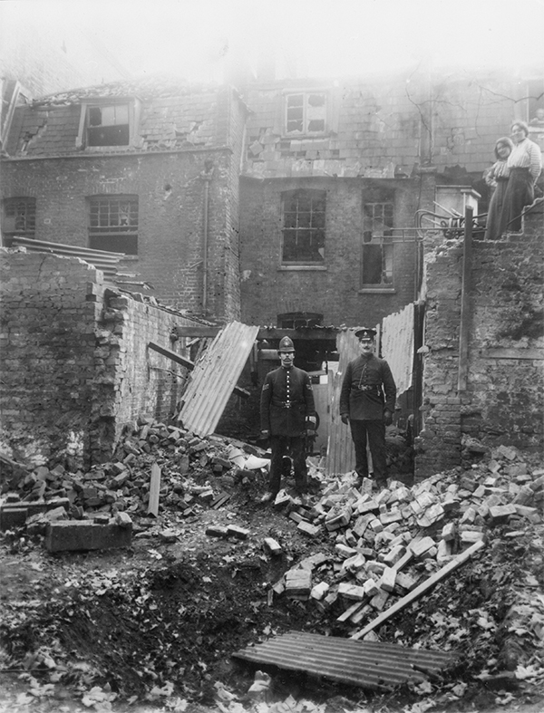
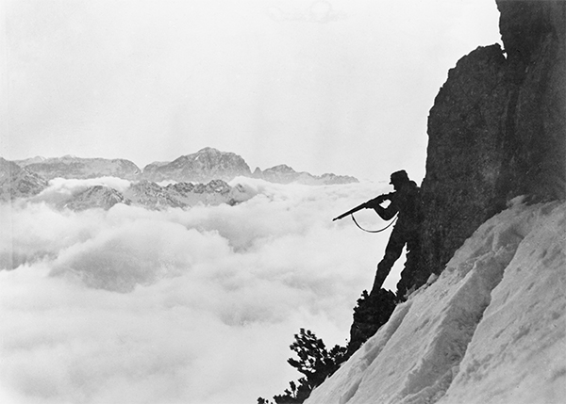
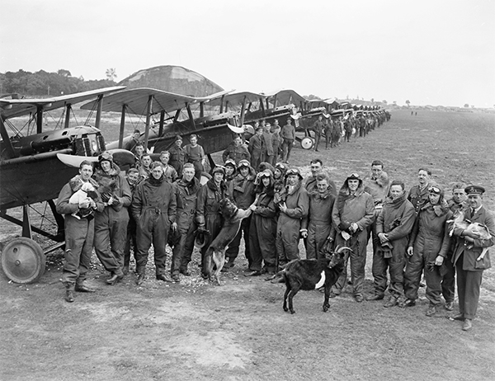
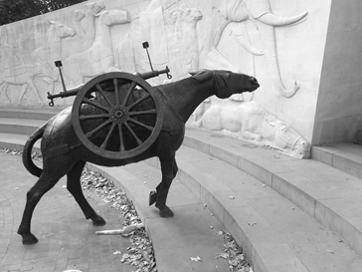
bomb
plane
soldiers
transport rifle mule
© IWM (Q 114805)
© IWM (HO 13)
© IWM (Q 12049)

Slide 5
Task 4 – Writing the numbers in words
a. 489
b. 1,566
c. 800,000
d. 541,300
e. 8,904,467
four hundred and eighty-nine
one thousand, five hundred and sixty-six
eight hundred thousand
five hundred and forty-one thousand, three hundred
eight million, nine hundred and four thousand, four hundred and sixty-seven

Slide 6
Task 5 – First World War numbers dictation
1914
1918
16,000,000
5,704,416
2,488,640
15,798,000

Slide 7
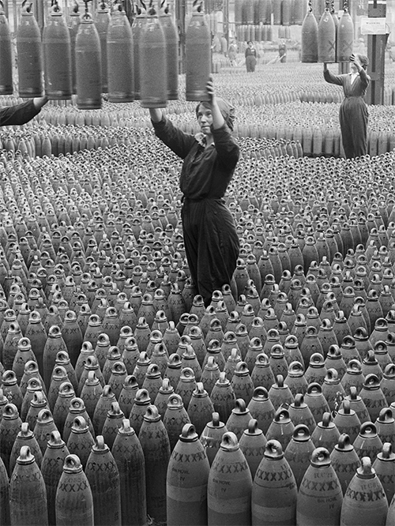
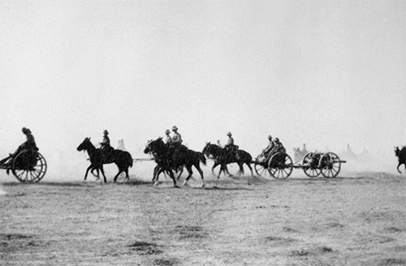
Task 6 – Numbers information exchange
© IWM (HU 51402)
© IWM (Q 30040)

